Slide 1
Advanced 3D graphics for movies and games (NPGR010) – Low-discrepancy sequences and quasi-Monte Carlo methods
Jiří Vorba, MFF UK/Weta Digital
jirka@cgg.mff.cuni.cz
Slides by prof. Jaroslav Křivánek, extended by Jiří Vorba

Slide 2
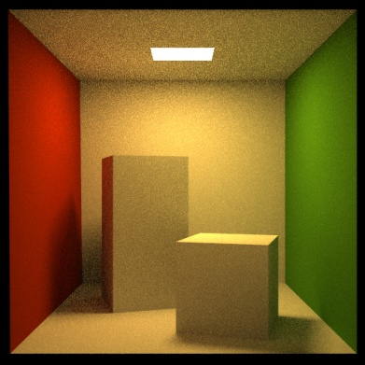
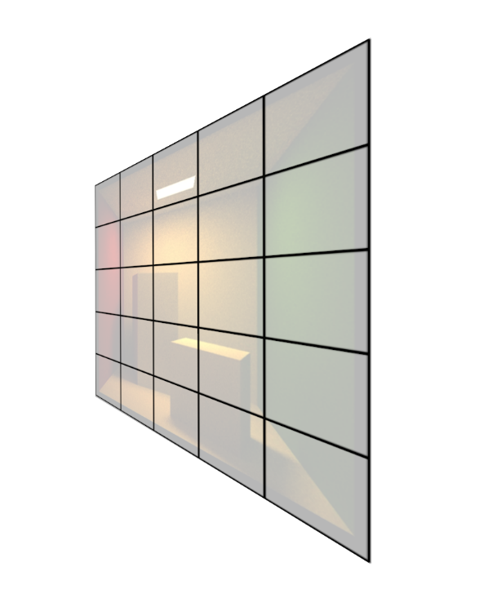
Path tracing

Slide 3
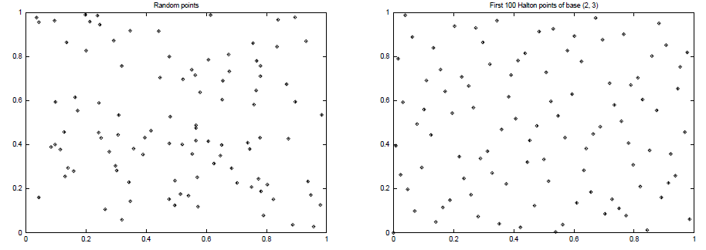
Quasi-Monte Carlo
Goal: Use point sequences that cover the integration domain as uniformly as possible, while keeping a ‘randomized’ look of the point set
High Discrepancy (clusters of points)
Low Discrepancy (more uniform)

Slide 4
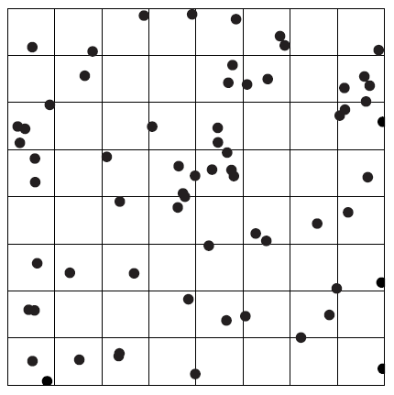
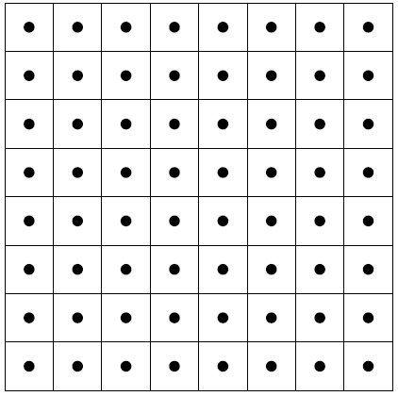
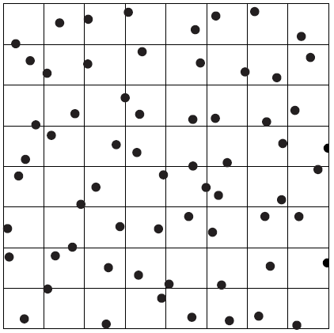
Recall: Stratified samples
Samples can still form clumps at borders
Suffers from course of dimensionality
Random
One sample per stratum
Jittered stratified sampling

Slide 5
Path tracing

Slide 6
estimateLin(x, omegaInAtX) // radiance incident at “x” from the direction “omegaInAtX”
{ // (“omegaInAtX” is pointing *away* from “x”)
Spectrum throughput = (1,1,1)
Spectrum accum = (0,0,0)
while(1) // we don’t cut off the path length now
{
hit = findNearestIntersection(x, omegaInAtX)
if noIntersection(hit) // ray leaves the scene – it “hits” the background
return accum + throughput * bkgLight.getLe(x, - omegaInAtX)
omegaOut := -omegaInAtX // omegaOut at hit.pos
if isOnLightSource(hit) // ray happened to directly hit a light source
accum += throughput * getLe(hit.pos, omegaOut) // “pick up” emission
// now estimate the reflected radiance
[omegaIn, pdfIn] := generateRandomDir(hit) // omegaIn at hit.pos
throughput *= 1/pdfIn * brdf(hit.pos, omegaIn, omegaOut) * dot(hit.n, omegaIn)
survivalProb = min(1, throughput.maxComponent())
if rand() < survivalProb // Russian Roulette – survive (reflect)
throughput /= survivalProb
x := hit.pos // “recursion”
omegaInAtX := omegaIn // “recursion”
else
break; // terminate path
}
return accum;
}

Slide 7
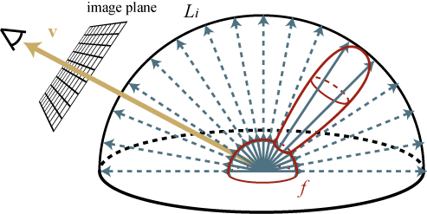
BSDF sampling
We need 2 random samples to cover hemisphere
$$L_{refl}(x, ω_{out})=\int_{H(x)}{L_{in}(x, ω_{in})⋅f_{r}({x,ω}_{in}→ω_{out})⋅\cos{θ_{in}} dω_{in}}$$

Slide 8
BSDF sampling
We need 2 random samples to cover hemisphere
+ 1 to choose a component
$$L_{refl}(x, ω_{out})=\int_{H(x)}{L_{in}(x, ω_{in})⋅f_{r}({x,ω}_{in}→ω_{out})⋅\cos{θ_{in}} dω_{in}}$$

Slide 9
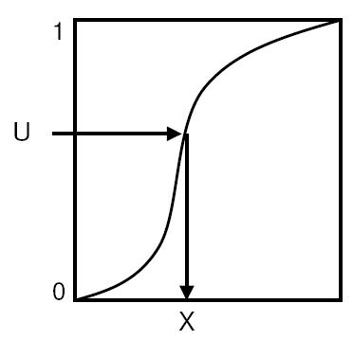
Transformation method – cdf inversion
U is uniformly distributed in [0,1]^{n}

Slide 10
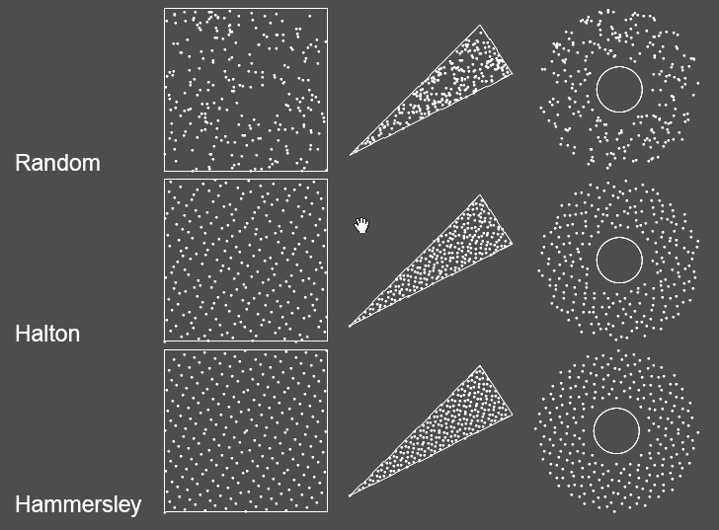
Transformation of point sets
Image credit: Alexander Keller

Slide 11
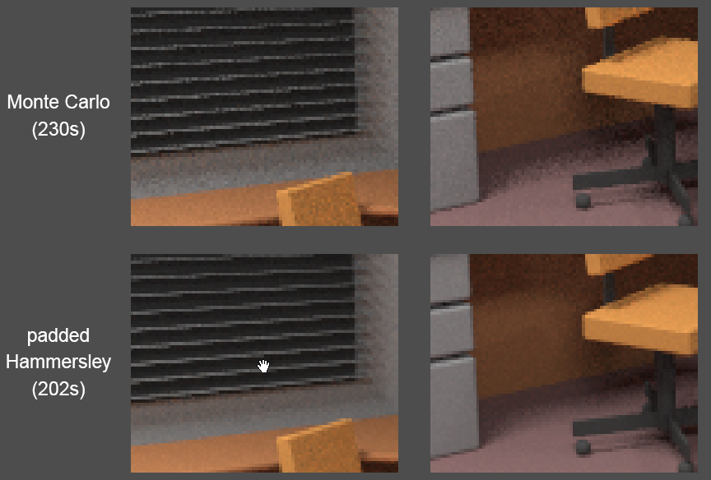
MC vs. QMC
Image credit: Alexander Keller

Slide 12
Random
Mersenne twister
Pseudorandom number generator
Available in C++11
32-bit wide (period)
Large state – 2.5KB
#include <random>
const uint32_t seed = 123;
std::mt19937 generator (seed);
std::uniform_real_distribution<float> dis(0.0, 1.0);
float ksi = dis(generator);

Slide 13
Random - seeding
Truly random – seed by current time
But we want deterministic renders!
Why?
Debugging!
Imagine chasing a source of firefly

Slide 14
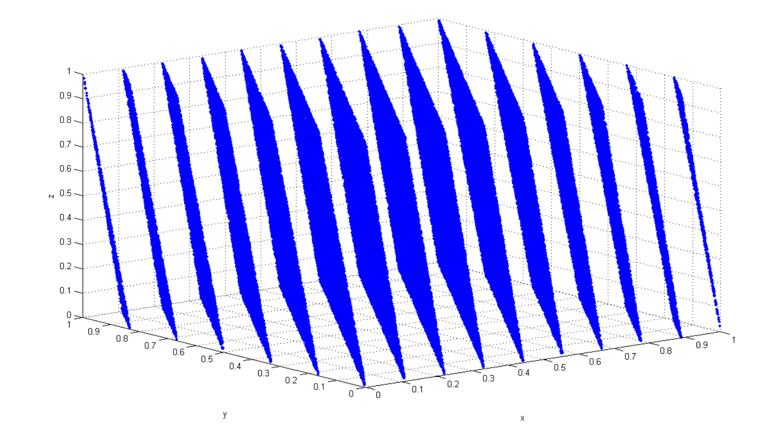
Stay away from srand() and rand()
Bad statistical properties
Short period (only 16-bit)
More details
https://channel9.msdn.com/Events/GoingNative/2013/rand-Considered-Harmful
#include <stdlib.h>
#include <time.h>
srand(time(NULL));
float ksi = rand() / (float) RAND_MAX;
Source: Wikipedia
Bad idea!

Slide 15
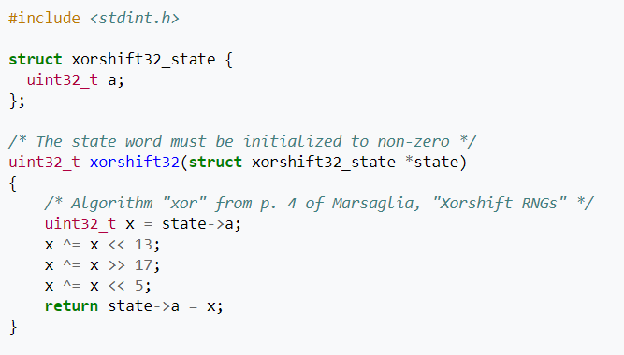
Random
Xorshift (by George Marsaglia)
Pseudorandom generator
Fast, tiny state
32-bit, (64-bit, 128-bit)
Xorshift+ (statistically as good as Mersenne twister)
Source: Wikipedia

Slide 16
Quasi Monte Carlo (QMC) methods
Use of strictly deterministic sequences instead of random numbers
Also true for pseudo-random numbers
All formulas as in MC, just the underlying proofs cannot reply on the probability theory (nothing is random)
Based on low-discrepancy sequences

Slide 17
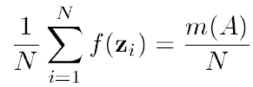
Defining discrepancy
s-dimensional “brick” function:
True volume of the “brick” function:
MC estimate of the volume of the “brick”:
number of sample points that actually fell inside the “brick”
total number of sample points

Slide 18
Discrepancy
Discrepancy (of a point sequence) is the maximum possible error of the MC quadrature of the “brick” function over all possible brick shapes:
serves as a measure of the uniformity of a point set
must converge to zero as N -> infty
the lower the better (cf. Koksma-Hlawka Inequality)

Slide 19
Koksma-Hlawka inequality
Koksma-Hlawka inequality
the KH inequality only applies to f with finite variation
QMC can still be applied even if the variation of f is infinite
„variation“ of f

Slide 20
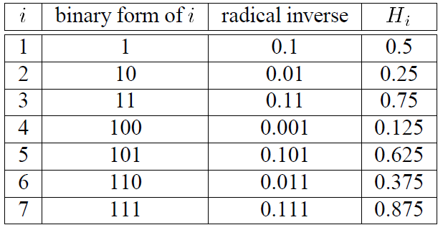
Van der Corput Sequence (base 2)
point placed in the middle of the interval
then the interval is divided in half
has low-discrepancy
Table credit: Laszlo Szirmay-Kalos

Slide 21
Van der Corput Sequence (base 2)
Table credit: Laszlo Szirmay-Kalos
0
1

Slide 22
Van der Corput Sequence (base 2)
Table credit: Laszlo Szirmay-Kalos
1
0
1

Slide 23
Van der Corput Sequence (base 2)
Table credit: Laszlo Szirmay-Kalos
2
1
0
1

Slide 24
Van der Corput Sequence (base 2)
Table credit: Laszlo Szirmay-Kalos
2
1
3
0
1

Slide 25
Van der Corput Sequence (base 2)
Table credit: Laszlo Szirmay-Kalos
4
2
1
3
0
1

Slide 26
Van der Corput Sequence (base 2)
Table credit: Laszlo Szirmay-Kalos
4
2
1
5
3
0
1

Slide 27
Van der Corput Sequence (base 2)
Table credit: Laszlo Szirmay-Kalos
4
2
6
1
5
3
0
1

Slide 28
Van der Corput Sequence (base 2)
Table credit: Laszlo Szirmay-Kalos
4
2
6
1
5
3
7
0
1

Slide 29
Van der Corput Sequence
b ... Base
radical inverse

Slide 30
Van der Corput Sequence
b ... Base
radical inverse
Example:
$$i=123 \\ b=10$$
$$123=3∗{10}^{0}+2∗{10}^{1}+1∗{10}^{2}$$ $→$ $$Φ_{10}\left(123\right)=\frac{3}{10}+\frac{2}{{10}^{2}}+\frac{1}{{10}^{3}}=0.321$$

Slide 31
Van der Corput Sequence (base b)
double radicalInverse(const int base, int i)
{
double digit, radical;
digit = radical = 1.0 / (double)base;
double inverse = 0.0;
while(i)
{
inverse += digit * (double)(i % base);
digit *= radical;
i /= base;
}
return inverse;
}

Slide 32
Van der Corput Sequence (base b)
Discrepancy of sequence P
$$D_{N}^{∗}\left(P\right)=O\left(\frac{\log{N}}{N}\right)$$

Slide 33
Sequences in higher dimension
Image credit: Alexander Keller

Slide 34
Sequences in higher dimension
Discrepancy
$$D_{N}^{∗}\left(x_{i}\right)=O\left(\frac{({\log{N)}}^{s}}{N}\right)$$
Image credit: Alexander Keller

Slide 35
Sequences in higher dimension
Image credit: Alexander Keller

Slide 36
Sequences vs sets
Set
Number of samples need to be known a-priory
Hammersley, stratified samples
Usually needs to be recomputed if we change N
Sequence
We don’t need to know number of samples beforehand
Points added without recomputing of previous points
Halton

Slide 37
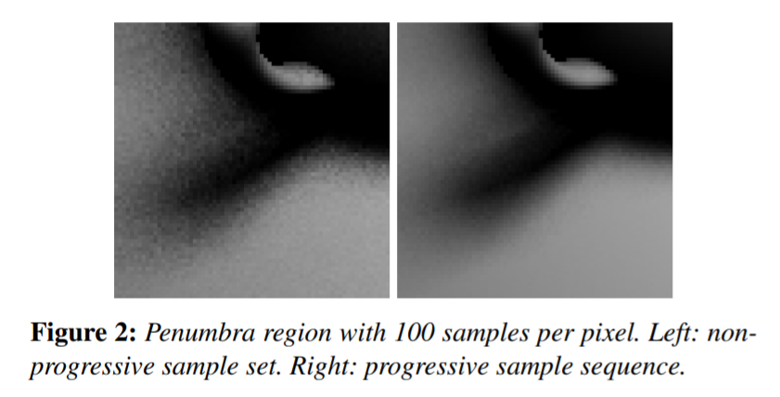
Progressive sequences/sets
Any prefix preserves low-discrepancy
Suitable for progressive rendering
Source: Christensen[2018]

Slide 38
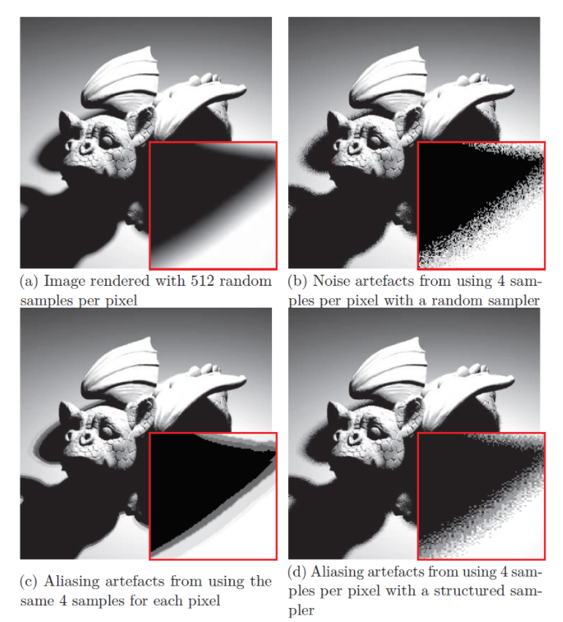
Quasi-Monte Carlo (QMC) Methods
Disadvantages of QMC:
Regular patterns can appear in the images (instead of the more acceptable noise in purely random MC)
Random scrambling can be used to suppress it
Source: http://extremelearning.com.au/

Slide 39
Scrambling
Low-dimensional projections show visible patterns
Mitigated by scrambling
$${(Φ}_{17}\left(i\right),Φ_{19}(i)), i=0…63$$

Slide 40
Scrambling - permutations
Low-dimensional projections show visible patterns
Mitigated by scrambling
$${(Φ}_{17}\left(i\right),Φ_{19}(i)), i=0…63$$

Slide 41
Scrambling - permutations
Apply the same permutation at every digit
$$Φ_{σ_{b }}\left(i\right)= \sum_{j=0}^{∞}{σ_{b}\left(a_{j}\left(i\right)\right)b^{−j−1}}$$
$${(Φ}_{17}\left(i\right),Φ_{19}(i)), i=0…63$$
$${(Φ}_{σ_{17}}\left(i\right),Φ_{σ_{19}}(i)), i=0…63$$

Slide 42
Scrambling – permutations by Faure
In general, permutations for each base can be arbitrary
Deterministic perms. by Faure
When b is even: Take and append
$$2σ_{\frac{b}{2}}$$
$$2σ_{\frac{b}{2}}+1$$
$${(Φ}_{17}\left(i\right),Φ_{19}(i)), i=0…63$$
$${(Φ}_{σ_{17}}\left(i\right),Φ_{σ_{19}}(i)), i=0…63$$

Slide 43
Scrambling – permutations by Faure
In general, permutations for each base can be arbitrary
Deterministic perms. by Faure
When b is odd: Take , increment each value , insert in the middle
$$≥\frac{b−1}{2}$$
$$σ_{b−1}$$
$$\frac{b−1}{2}$$
$${(Φ}_{17}\left(i\right),Φ_{19}(i)), i=0…63$$
$${(Φ}_{σ_{17}}\left(i\right),Φ_{σ_{19}}(i)), i=0…63$$

Slide 44
Scrambling – permutations by Faure
Faure permutations can be implemented efficiently without branching
$${(Φ}_{17}\left(i\right),Φ_{19}(i)), i=0…63$$
$${(Φ}_{σ_{17}}\left(i\right),Φ_{σ_{19}}(i)), i=0…63$$

Slide 45
Use in path tracing
Objective: Generated paths should cover the entire high-dimensional path space uniformly
Approach:
Paths are interpreted as “points” in a high-dimensional path space
Each path is defined by a long vector of “random numbers”
Subsequent random events along a single path use subsequent components of the same vector
Only when tracing the next path, we switch to a brand new “random vector” (e.g. next vector from a Halton sequence)

Slide 46
Path tracing
Path “i” sampled based on the “i-th” sample from the sequence
$$U_{i}=(u_{o},…, u_{10})$$
BSDF
Time, lens, pixel
$$(u_{5},u_{6},u_{7})$$
BSDF
$$(u_{o},u_{1},u_{2},u_{3}, u_{4})$$
$$(u_{8},u_{9},u_{10})$$

Slide 47
Progressive rendering with Halton
Option 1:
Halton sequence per pixel, use different scrambling
Loose low-discrepancy properties in the image plane
In fact results into stratified sampling in the image plane
Option 2:
Use nearest power of two to your resolution
It is possible to compute index of n-th sample in the Halton sequence given the pixels coordinates
Skip samples falling outside your actual pixels
Details: PBRT, 3rd edition – Chapter 7.4.2.

Slide 48
Further study material
(t,s)-sequences
(0,2)- sequence: Sobol sequence generator matrices
Rank-1 lattice sequences
Multi-jittered samples
References
https://sites.google.com/view/myfavoritesamples
Christiane Lemieux: Monte Carlo and Quasi-Monte Carlo Sampling [2008]

